Slide 1
Cloud Computing Characteristics, Service Models & Deployment Models
Prof. Dr. Pardeep Kumar

Slide 2
Agenda
Characteristics
Service Models
Deployment Models

Slide 3
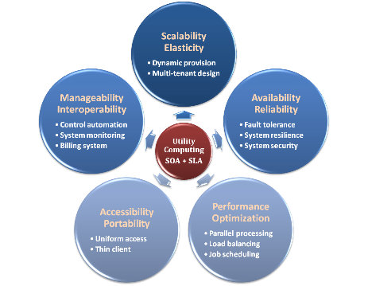
Characteristics
Scalability and elasticity
Availability and reliability
Manageability & interoperability
Accessibility and portability
Performance and optimization

Slide 4
Scalability & Elasticity
Scalability is the ability to handle growing workload gracefully.
Just by adding resources either making hardware stronger (scale up) or adding additional nodes (scale out).
Elasticity is the ability to grow or shrink resources dynamically to adapt to workload changes in an autonomic manner
Maximizing the use of resources, usually in relation to scale out.
But how to achieve these properties?
Dynamic provisioning
Multi-tenant design

Slide 5
Dynamic Provisioning
The client can quickly acquire required resources as per their dynamic requirements without making manual adjustments.
Meet seasonal demand variations
Meet demand variations between different industries
Meet burst demand for some extraordinary events

Slide 6
Multi-tenant Design
Multiple customers are using the same computing resources. Though they share resources, cloud customers are not aware of each other, and their data is kept totally separate.
Each client organization works with a customized virtual application instance.
It provides a high degree of customization to support each organization's needs.
And offers QoS by providing adequate levels of security and robustness.

Slide 7
Availability & Reliability
Availability is a degree to which a system or equipment is in a specified operable and committable state
Reliability is the ability of a system to perform its required functions under stated conditions for a specified period.
But how to achieve these properties?
Fault tolerance system
Resilient system
Reliable system security

Slide 8
Manageability & Interoperability
Manageability is the enterprise-wide administration of cloud computing systems.
Interoperability is a property of a product or system to work across different products or systems, present or future, without any restricted access or implementation.
But how to achieve these properties?
System control automation
System state monitoring

Slide 9
Billing System
Users pay as many as they used.
Cloud provider must first determine the list of service usage price and then record the resource or service usage of each user, and then charge users by these records.
How can cloud provider know users’ usage?
Get those information by means of monitoring system.
Automatically calculate the total cost which user should pay.
And automatically request money from use’s banking account.

Slide 10
Performance & Optimization
Cloud providers make use of powerful infrastructure or other underlining resources to build up a highly performed and highly optimized environment
But how to achieve this property?
Parallel computing
Load balancing
Job scheduling

Slide 11
Parallel Processing
A form of computation in which many calculations are carried out simultaneously
large problems can often be divided into smaller ones, which are then solved concurrently.
Parallelism in different levels:
Bit level parallelism
Instruction level parallelism
Data level parallelism
Task level parallelism

Slide 12
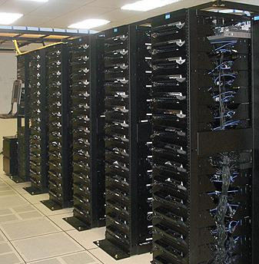
Parallel Processing
Hardware approaches
Multi-core computer
Symmetric multi-processor
General purpose GPUs
Vector processor
Distributed computing
Cluster, Grid, Edge, Fog
Software approaches
Parallel programming language
Automatic parallelization

Slide 13

Load Balancing
A technique to distribute workload evenly across two or more systems
For optimal resource utilization
maximize throughput
minimize response time
avoid overloading
Why should be load balanced?
Improve resource utilization
Improve system performance
Improve energy efficiency

Slide 14
Job Scheduling
A software application that supports unattended background executions, commonly known as batch processing.
What should be scheduled in Cloud?
Computation intensive tasks
Dynamic growing and shrinking tasks
Tasks with complex processing dependency
How to approach?
Use pre-defined workflow
System automatic configuration

Slide 15
Accessibility & Portability
Accessibility is the degree to which a product, device, service, or environment is accessible by as many people as possible.
Service portability is the ability to access services using any devices, anywhere, continuously with mobility support and dynamic resource adaptation.
But how to achieve these properties?
Uniform access
Thin client

Slide 16

Uniform Access
How do users access cloud services?
Users from different operating systems or platforms should be able to directly be served.
Nowadays, web browser technique is one of the most widespread platform in almost any intelligent electronic devices.

Slide 17
Thin Client
A computer or a program which depends heavily on some other computer to fulfill its traditional computational roles.
Characteristics :
Cheap client hardware
Diversity of end devices
Including cell phones, gadgets and smart TV.
Client simplicity
Client local systems do not need complete operational functionalities.

Slide 18

Service Models
Choose the service you need.

Slide 19
A Simple Analogy
Say, you just moved to a city, and you are looking for a place to live.
What options do you have
Built a new house
Buy an empty house
Live in a hotel

Slide 20
Options to chose from
Let’s built a new house
You can fully control everything you like your new house to have. But that is a hard work
If you buy an empty house
You can customize some part of your house. But never change the original architecture.
How about live in a hotel?
You can enjoy your life, but there is nothing you can do with the house except living in it.

Slide 21
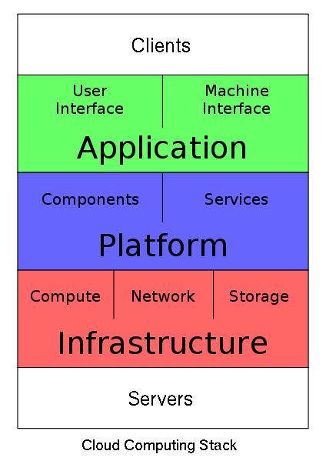
Cloud Computing Stack

Slide 22
Service Models Overview
Infrastructure as a service (IaaS)
You rent a virtual server
Amazon, Rackspace, GoGrid, etc.
Platform as a service (PaaS)
You rent an abstract machine
Google app engine, Salesforce, etc.
Software as a service (SaaS)
You rent a capability
Exchange hosting, Wordpress hosting, etc.

Slide 23
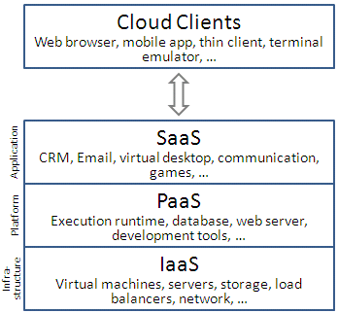
Services of Cloud
Notes:
SaaS is a kind of services where in many users can make use of the software hosted by the service provider and pay only for time its being used. It will be better than buying the hardware and software as keeps off the burden of updating the software to the latest version, licensing and is of course more economical. Some example service providers are Salesforce, Customer Relationships Management(CRM) system and Google Apps.
PaaS provides a high-level integrated environment to design, build, test, deploy and update online custom applications. Some example service providers are Google’s App Engine , Microsoft Azure , RightScale and SalesForce .
IaaS refers to the services provided to the users to use processing power, storage, network and other computing resources, to run any software including operating systems and applications. Some of the IaaS providers are AWS, Eucalyptus, Open Stack, GoGrid and Flexiscale

Slide 24
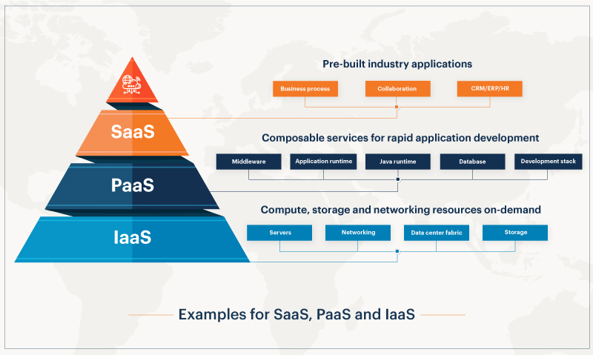
Services of Cloud
Notes:
SaaS is a kind of services where in many users can make use of the software hosted by the service provider and pay only for time its being used. It will be better than buying the hardware and software as keeps off the burden of updating the software to the latest version, licensing and is of course more economical. Some example service providers are Salesforce, Customer Relationships Management(CRM) system and Google Apps.
PaaS provides a high-level integrated environment to design, build, test, deploy and update online custom applications. Some example service providers are Google’s App Engine , Microsoft Azure , RightScale and SalesForce .
IaaS refers to the services provided to the users to use processing power, storage, network and other computing resources, to run any software including operating systems and applications. Some of the IaaS providers are AWS, Eucalyptus, Open Stack, GoGrid and Flexiscale

Slide 25
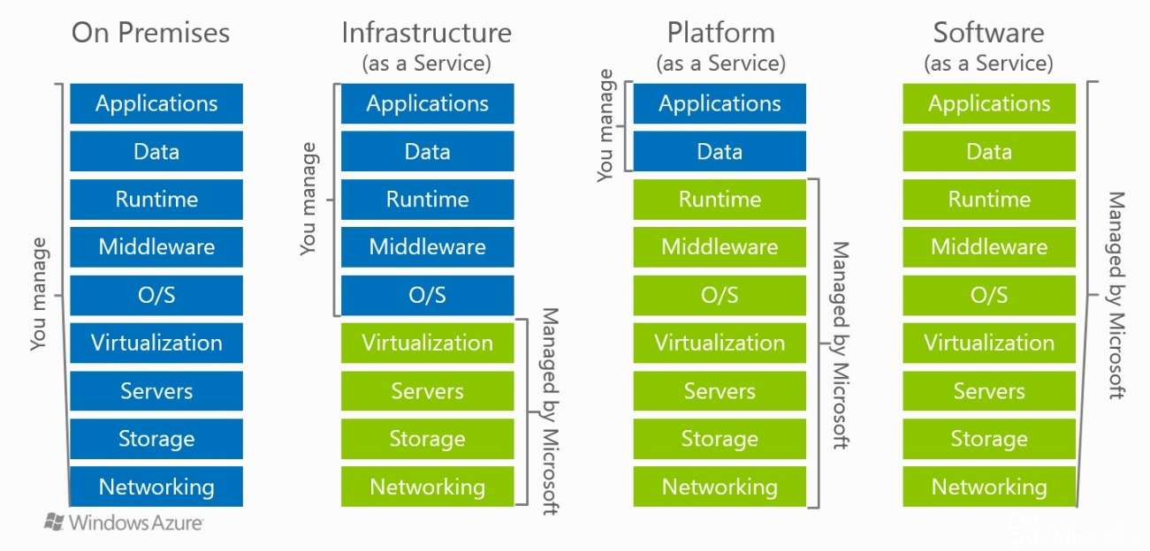
Services of Cloud

Slide 26
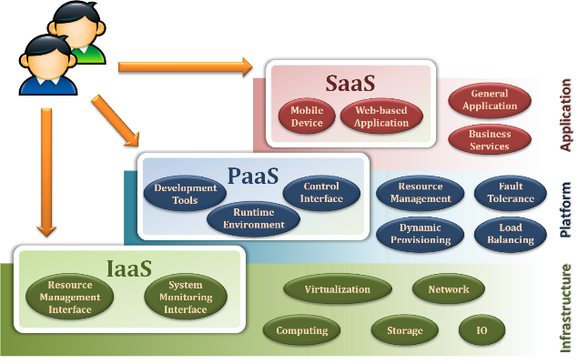
Service Model Overview

Slide 27
Infrastructure as a Service
laaS is the delivery of technology infrastructure as an on demand scalable service.
laaS provides access to fundamental resources such as physical machines, virtual machines, virtual storage, etc.
The capability provided to the consumer is to provision processing, storage, networks, and other fundamental computing resources
The consumer does not control the underlying infrastructure but has control over OS, storage, deployed applications, and possibly limited control of select networking components.

Slide 28
Infrastructure as a Service
Usually, billed based on usage
Usually, multi tenant virtualized environment
Can be coupled with Managed Services for OS and application support
Examples :
Amazon EC2
Eucalyputs
OpenNebula

Slide 29
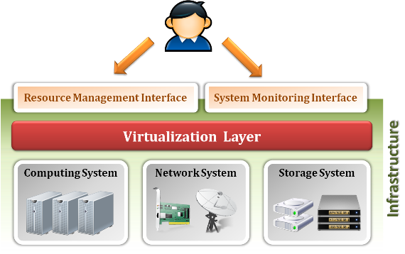
Infrastructure as a Service

Slide 30
Infrastructure as a Service
Enabling technique - Virtualization
Virtualization is an abstraction of logical resources away from underlying physical resources.
Virtualization technique shift OS onto hypervisor.
Multiple OS share the physical hardware and provide different services.
Improve utilization, availability, security and convenience.

Slide 31
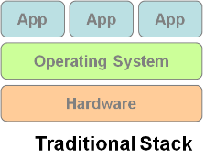
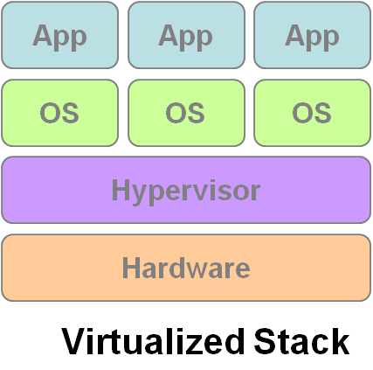
Infrastructure as a Service
VM1
VM2
VM3

Slide 32
Infrastructure as a Service
Properties supported by virtualization technique :
Manageability and Interoperability
Availability and Reliability
Scalability and Elasticity

Slide 33
IaaS - Summary
On demand computing resources
Eliminate the need of far ahead planning
No up-front commitment
Start small and grow as required
No physical contract, Only credit card!
Pay for what you use
No maintenance
Measured service
Scalability
Reliability

Slide 34
Platform as a Service
PaaS provides development & deployment tools, etc.
PaaS provides all of the facilities required to support the complete life cycle of building and delivering web applications and services entirely from the Internet.
Typically applications must be developed with a particular platform in mind.
Multi tenant environments
Highly scalable multi tier architecture

Slide 35
Platform as a Service
To the consumer is to deploy consumer-created applications and tools supported by the provider on the cloud.
The consumer does not manage or control the underlying cloud infrastructure including network, servers, OS, or storage
Only has control over the deployed applications
Examples :
Microsoft Windows Azure
Google App Engine
Hadoop

Slide 36
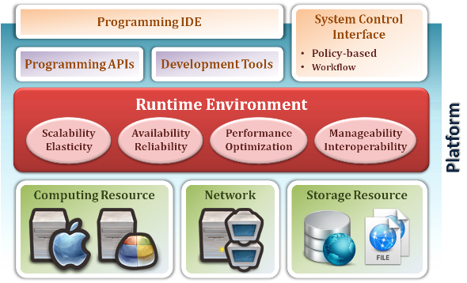
Platform as a Service

Slide 37
Platform as a Service
Enabling technique – Runtime Environment Design
It refers to collection of software services available. Usually implemented by a collection of program libraries.
Common properties in Runtime Environment :
Manageability and Interoperability
Performance and Optimization
Availability and Reliability
Scalability and Elasticity

Slide 38
PaaS - Summary
PaaS is the development platform that abstract the infrastructure, OS, and middleware to drive developer productivity.
PaaS enabling technique
Runtime Environment
PaaS provide services
Programming IDE
Programming APIs
Development tools
System Control Interface

Slide 39
Software as a Service
SaaS model allows to use software applications as a service to end users.
SaaS is a software delivery methodology that provides licensed multi-tenant access to software and its functions remotely as a Web-based service.
Usually, billed based on usage
Usually, multi tenant environment
Highly scalable architecture

Slide 40
Software as a Service
Allows use of provider’s applications on a cloud infrastructure.
The applications are accessible from various client devices through a thin client interface such as a web browser.
The consumer does not manage or control the underlying cloud infrastructure including network, servers, OS, storage, or even individual application capabilities
with the possible exception of limited user-specific application configuration settings.
Examples :
Google Apps (e.g., Gmail, Google Docs, Google sites, …etc)
SalesForce.com
EyeOS

Slide 41
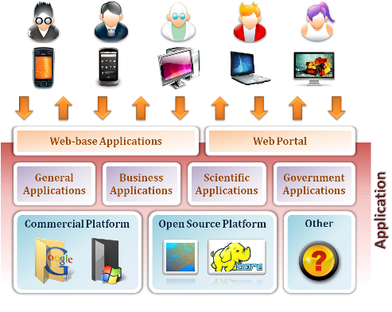
Software as a Service

Slide 42
Software as a Service
Enabling Technique – Web Service
Viewing the Internet as a computing platform
Running interactive applications through a web browser
Leveraging interconnectivity and mobility of devices
Enhanced effectiveness with greater human participation
Properties provided by Internet :
Accessibility and Portability

Slide 43
SaaS - Summary
SaaS is the finished applications that you rent and customize.
SaaS enabling technique
Web Service
SaaS provide services
Web-based Applications
General applications
Business applications
Scientific applications
Government applications
Web Portal

Slide 44
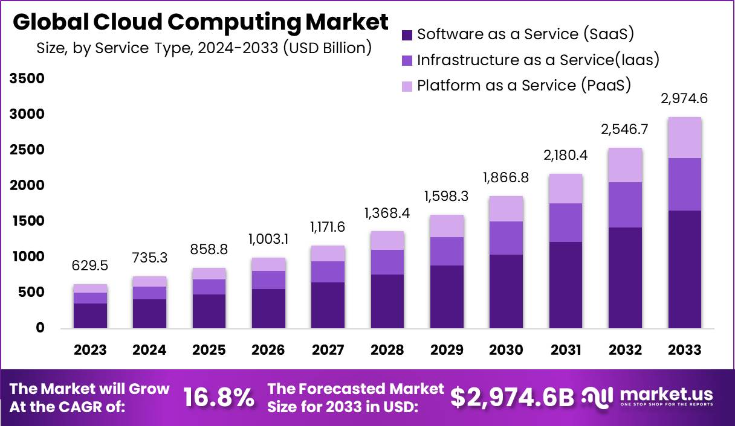
Cloud Market

Slide 45
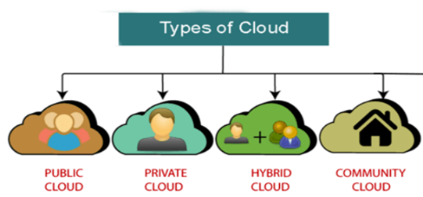
Cloud Deployment Models
Public Cloud
Private Cloud
Community Cloud
Hybrid Cloud
Each can exhibit the all the discussed characteristics
Differences is basically in the scope and access of published cloud services

Slide 46
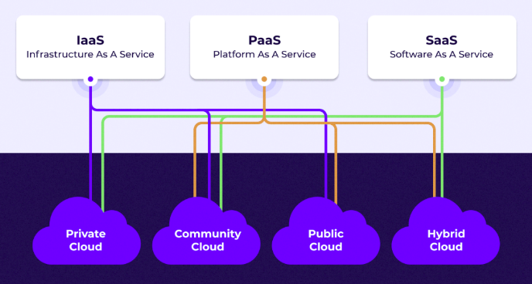
Deployment Models

Slide 47
Public Cloud
Available to the public or a large industry group and is owned by an organization selling cloud services.
Also known as external cloud or multi-tenant cloud, this model essentially represents a cloud environment that is openly accessible.
Basic characteristics :
Homogeneous infrastructure
Common policies
Shared resources and multi-tenant
Leased or rented infrastructure
Economies of scale

Slide 48
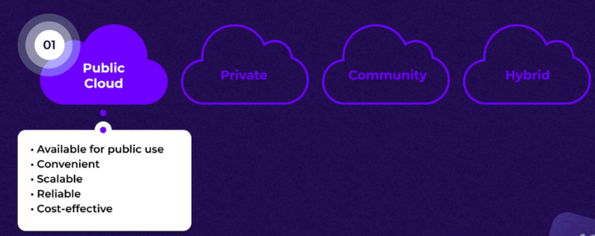
Public Cloud

Slide 49
Private Cloud
Operated solely for an organization. It may be managed by the organization or a third party and may exist on premise or off premise.
Also referred to as internal cloud or on-premise cloud, it intentionally limits access to its resources to service consumers that belong to the same organization that owns the cloud.
Basic characteristics :
Heterogeneous infrastructure
Customized and tailored policies
Dedicated resources
In-house infrastructure
End-to-end control

Slide 50
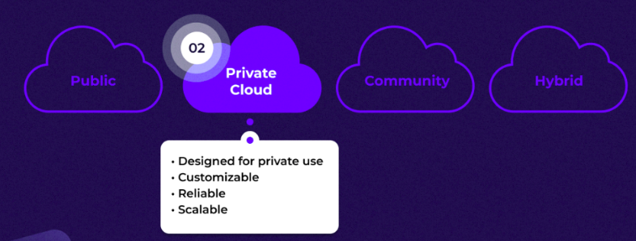
Private Cloud

Slide 51
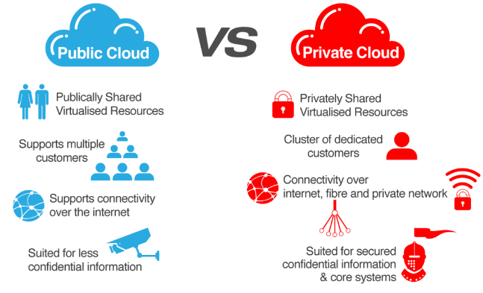
Public vs. Private

Slide 52
Community Cloud
The cloud infrastructure is shared by several organizations and supports a specific community that has shared concerns
These community, or multi-tenant, cloud models work best if each participating organization has similar security, privacy, storage, and other performance requirements.
In addition, partners can participate in joint projects and share the costs and tasks of implementation and maintenance.

Slide 53
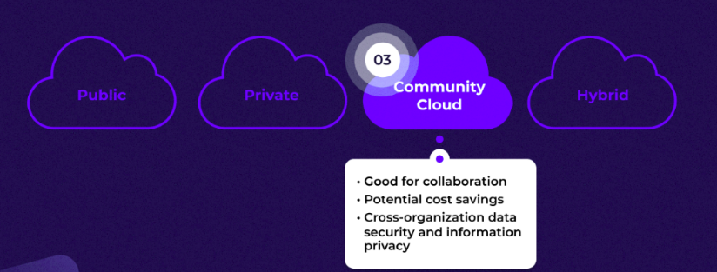
Community Cloud

Slide 54
Hybrid Cloud
The cloud infrastructure is a composition of two or more clouds (private, community, or public) that remain unique entities but are bound together by standardized or proprietary technology that enables data and application portability
For example, cloud bursting for load-balancing between clouds

Slide 55
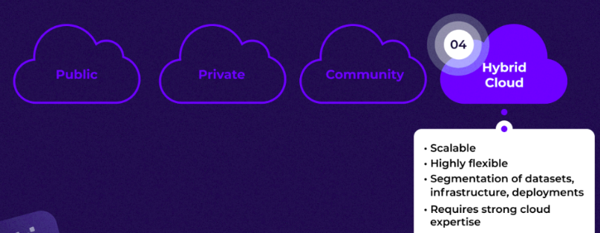
Hybrid Cloud

Slide 56
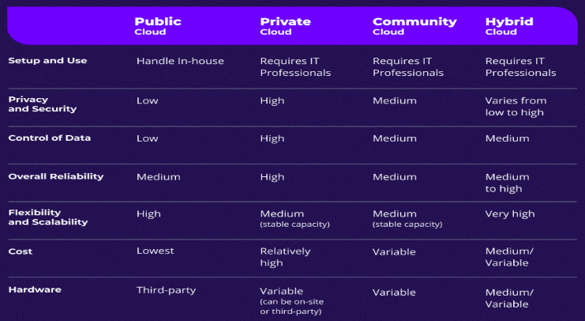
Comparison

Slide 57
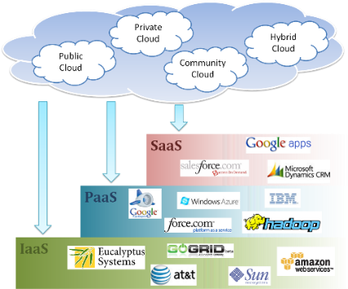
Cloud Ecosystem

